Slide 1

Doc33 Power Receptacle R/R
Dec 6, 2011

Slide 2
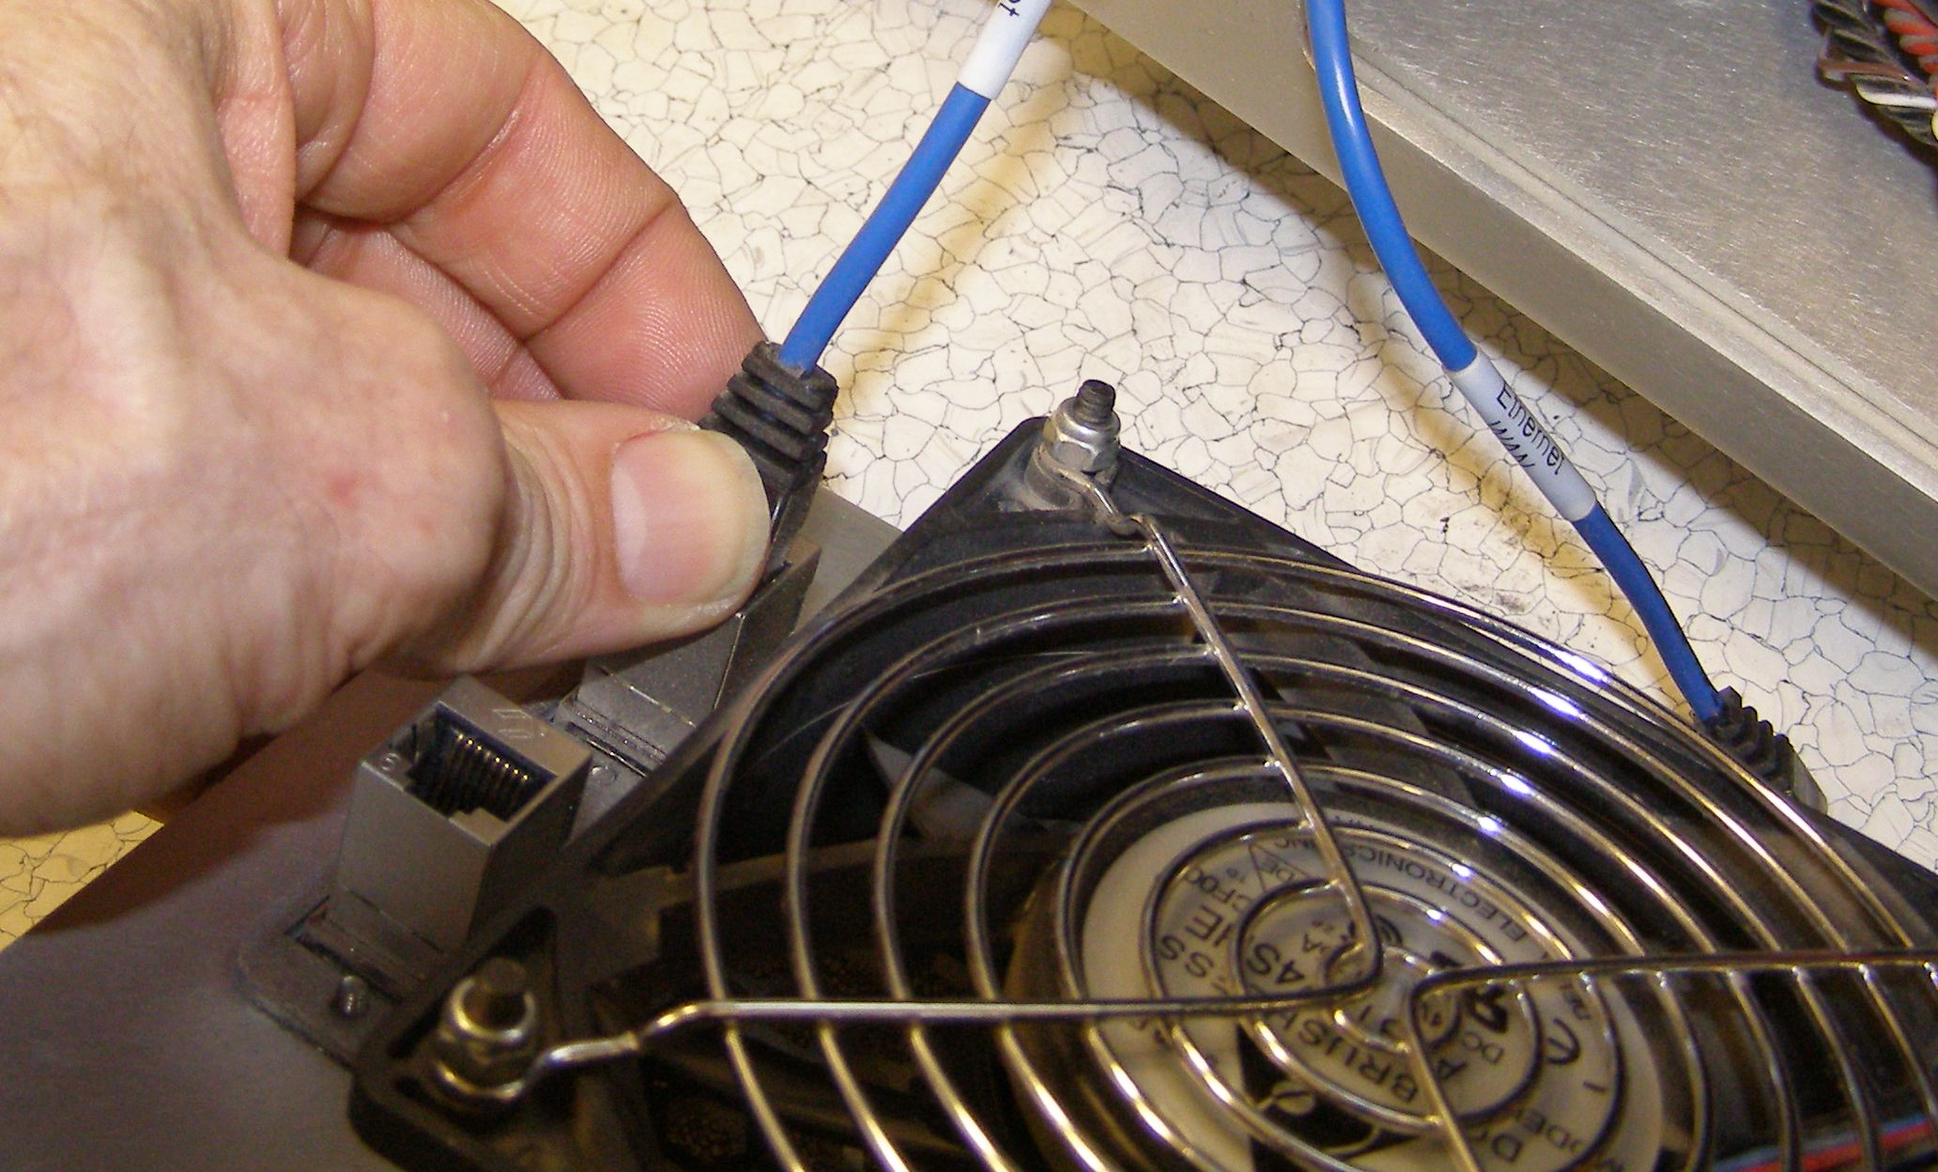
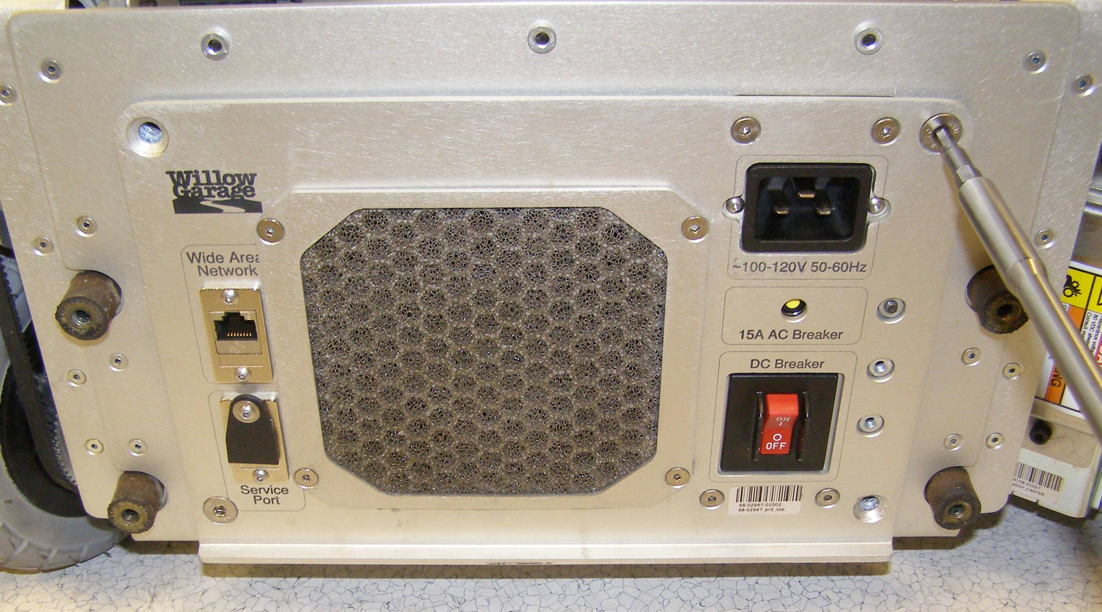
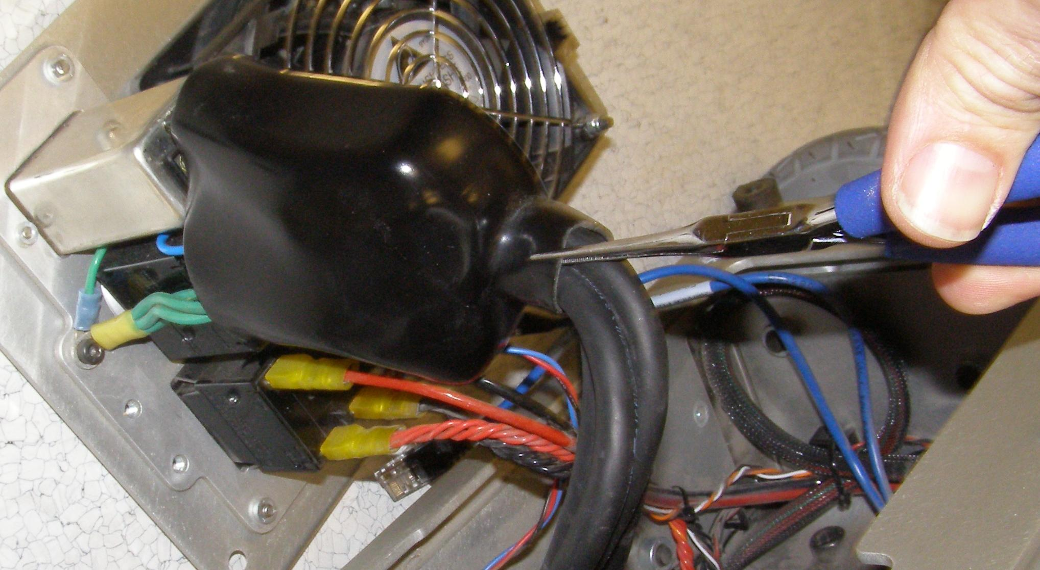
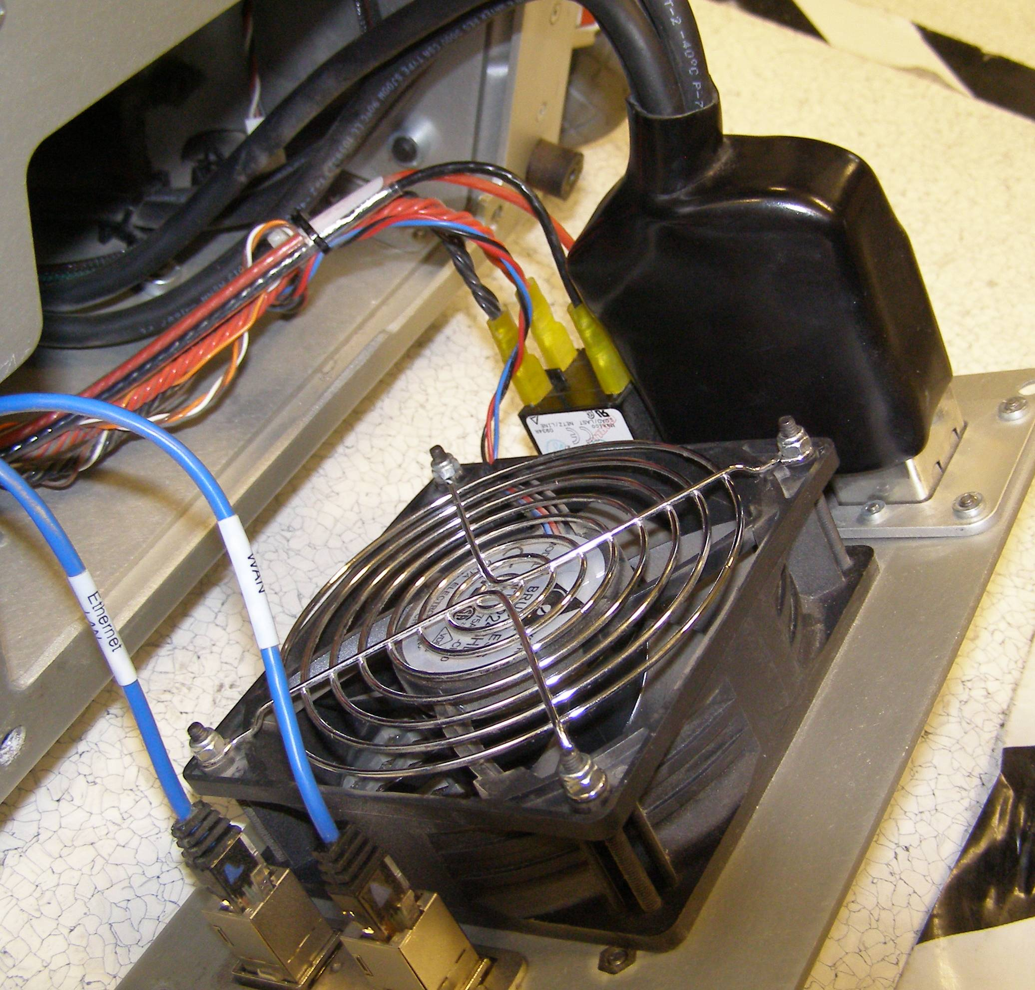
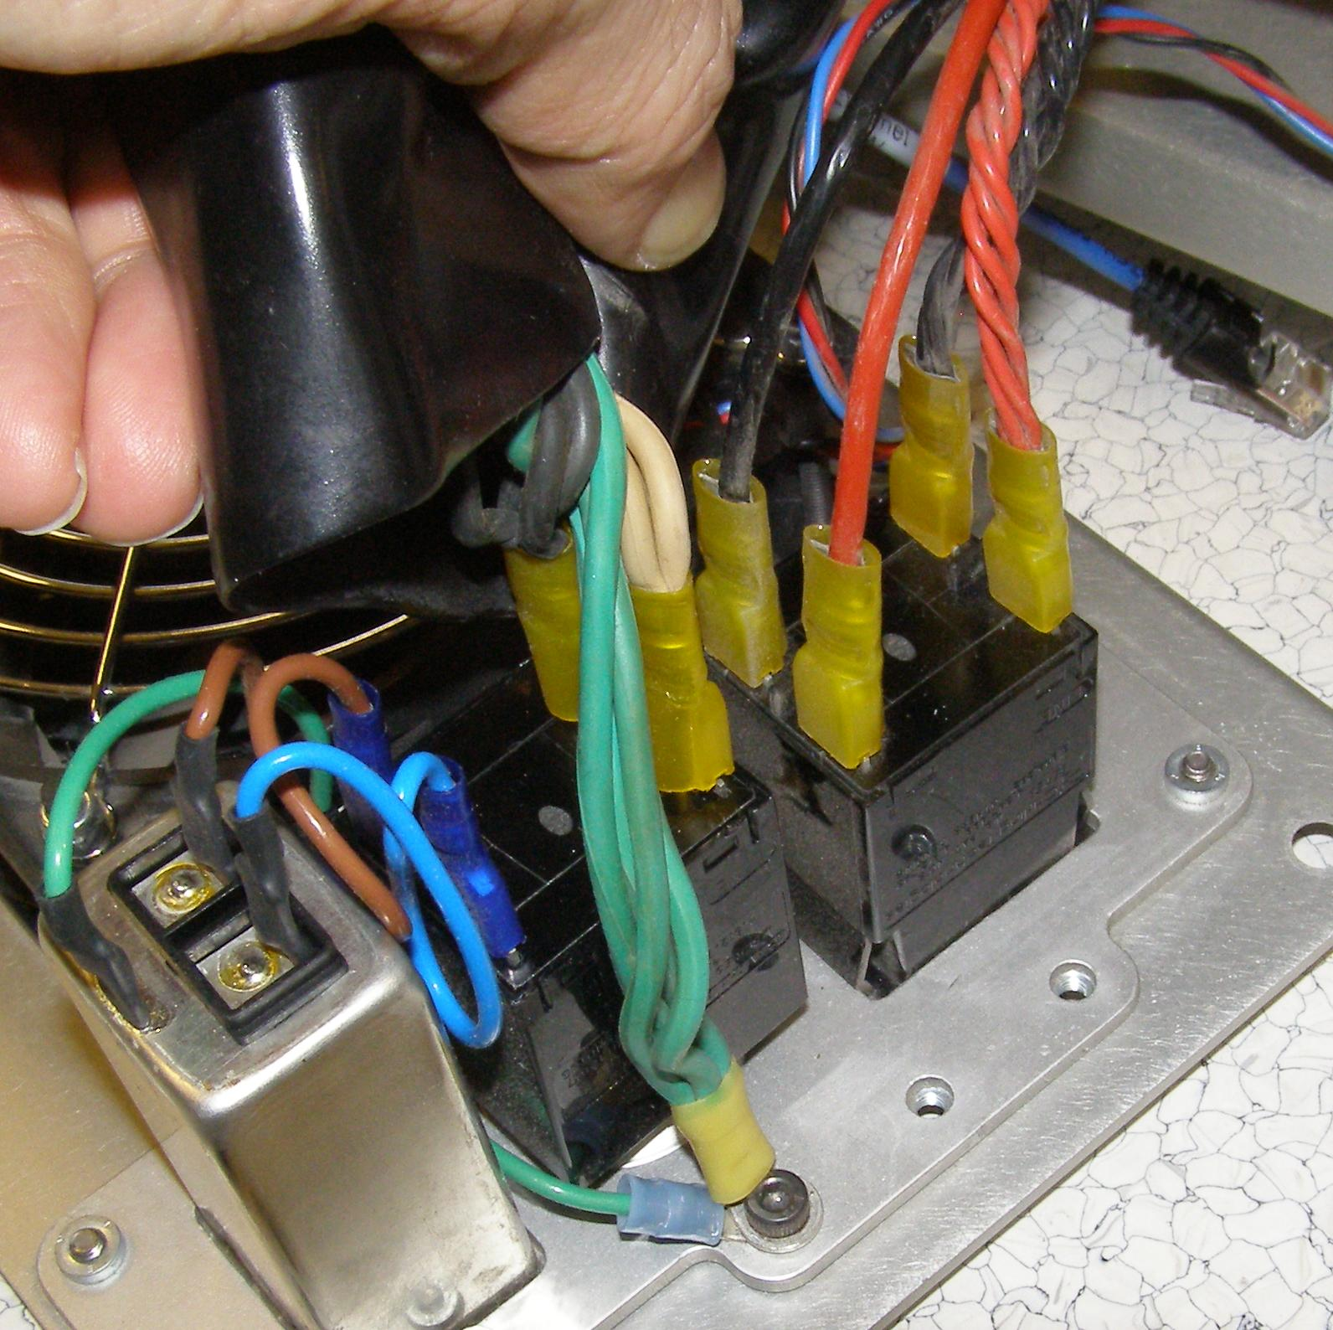
Power Receptacle R/R
The power receptacle is part of the Rear Sub-panel Assembly 68-04046 which is replaced as a unit. The Rear Base Sub-assembly 68-02810 must be removed first.
Before starting verify that the Robot is turned off.
Following Doc10 remove the Rear Skirt.
Rear Base Sub-assembly 68-02810 removal
  Using the 4mm bit with the T-handle remove the 4 mounting screws. (Fig 1)
  Carefully pull off and place the panel on the floor. Use scuff protection if needed. (Fig 2)
  Disconnect the two Ethernet cables. (Fig 3)
Fig 3
Fig 1
  Using the needle nose pliers carefully pull the rubber boot up about 3 inches, just enough to gain access to the spade lug contacts as shown. This is a slow process so don't use to much force. (Fig 4,5)
Fig 4
Fig 2
Fig 5

Slide 3
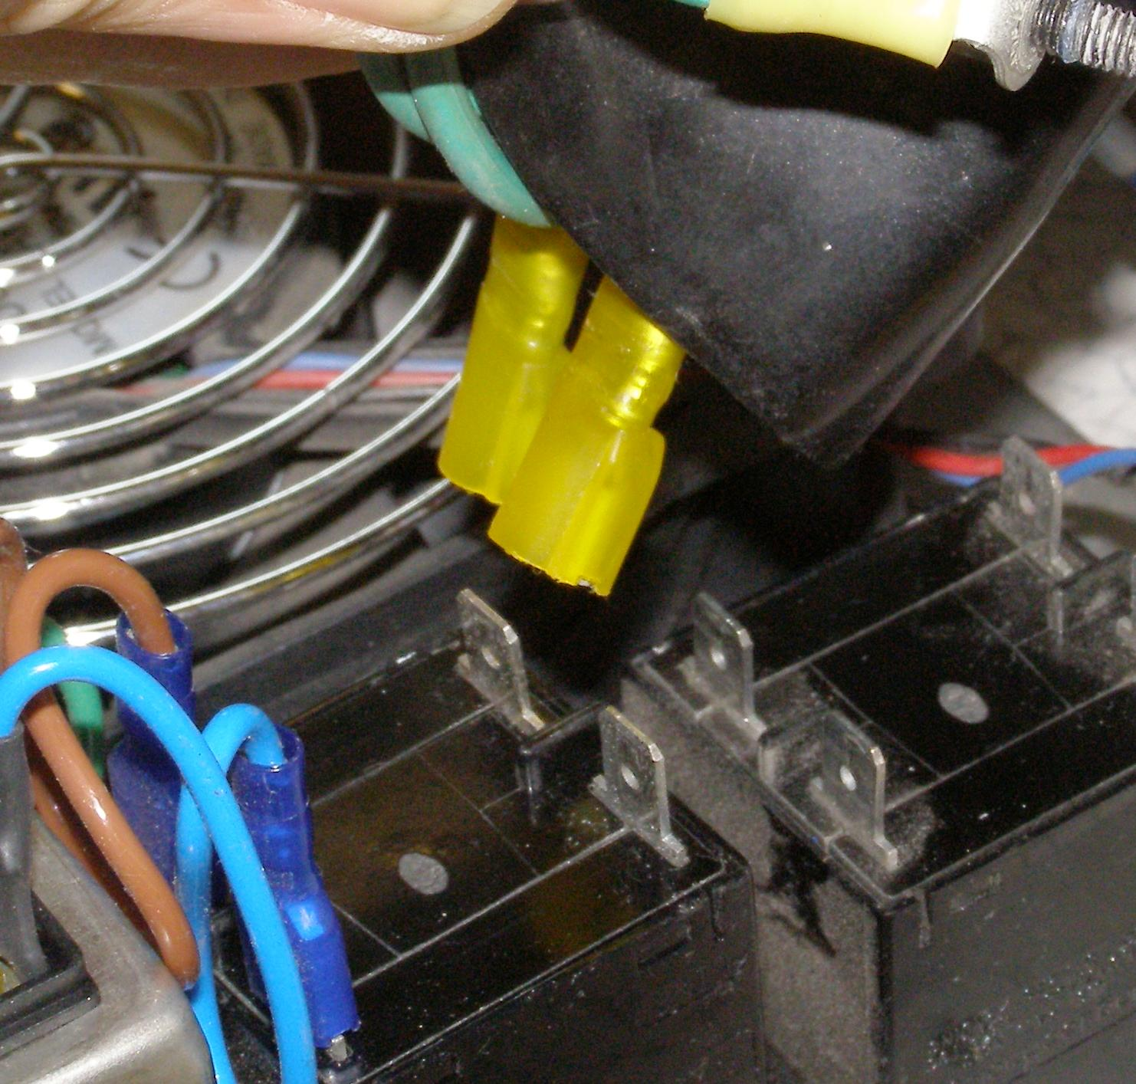
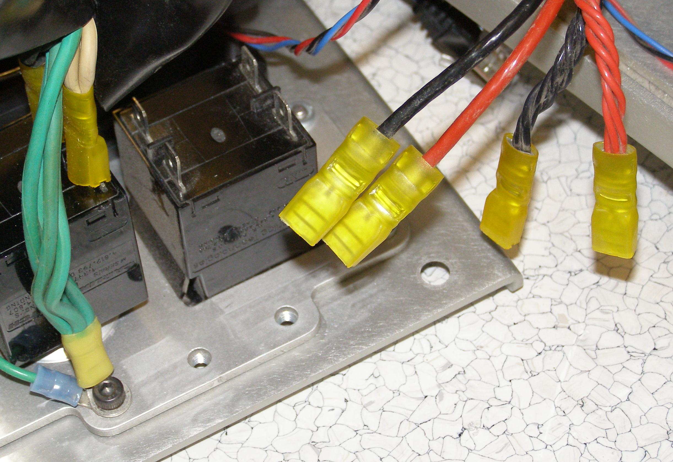
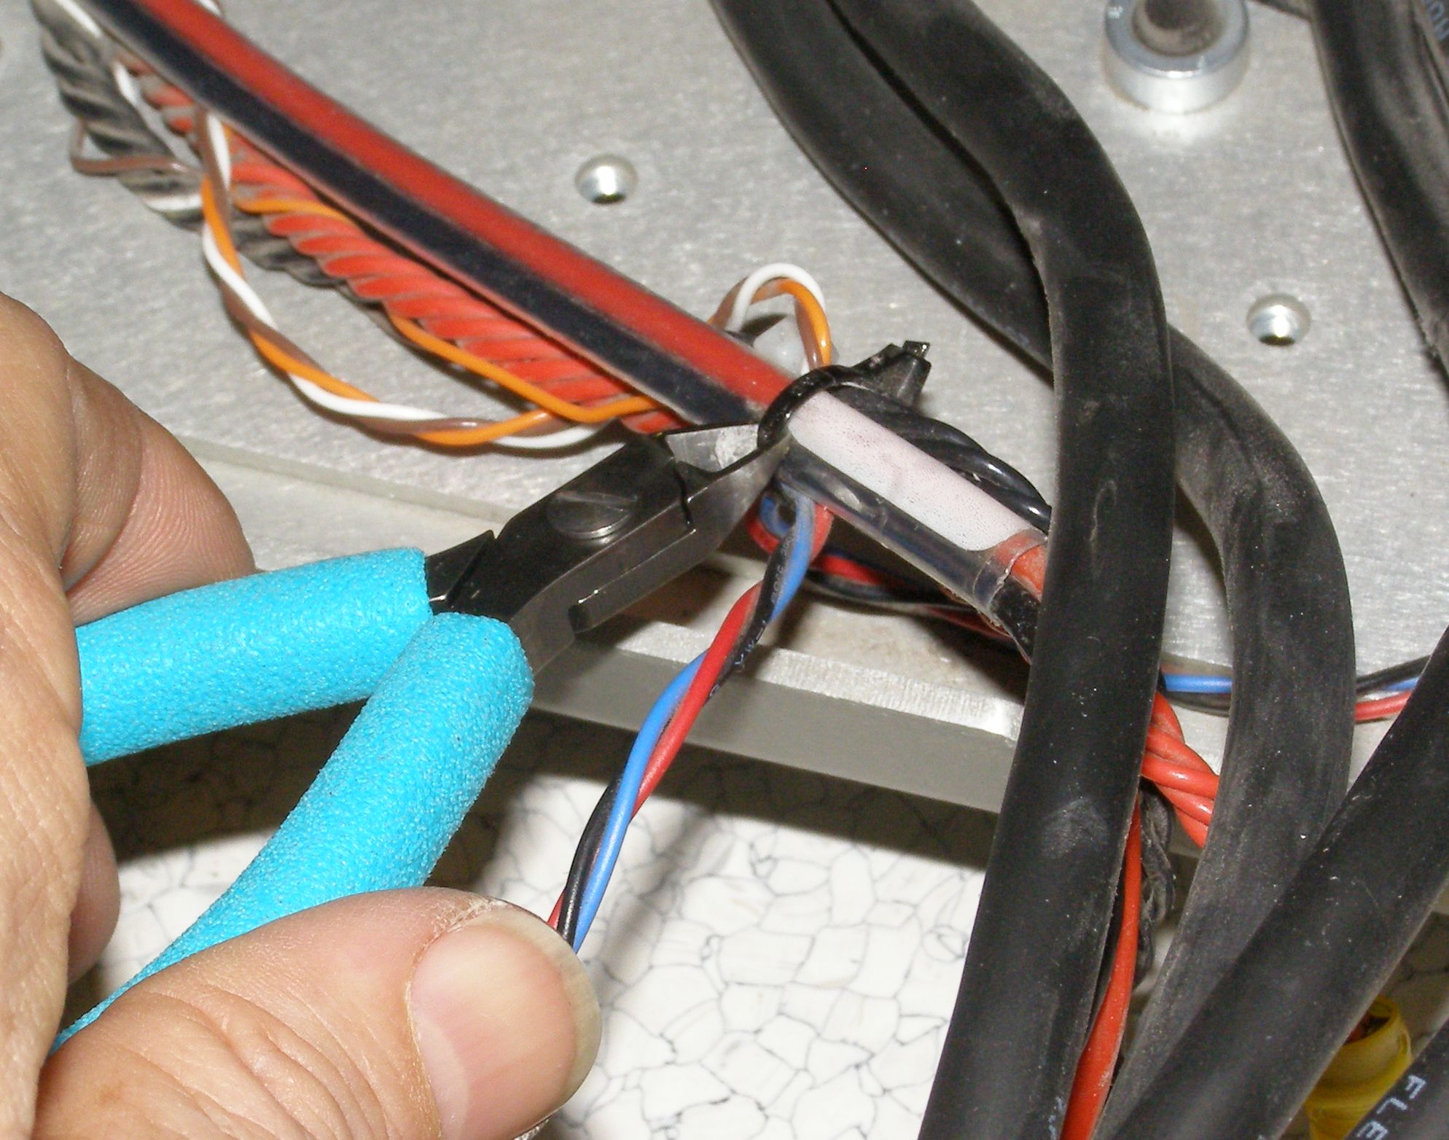
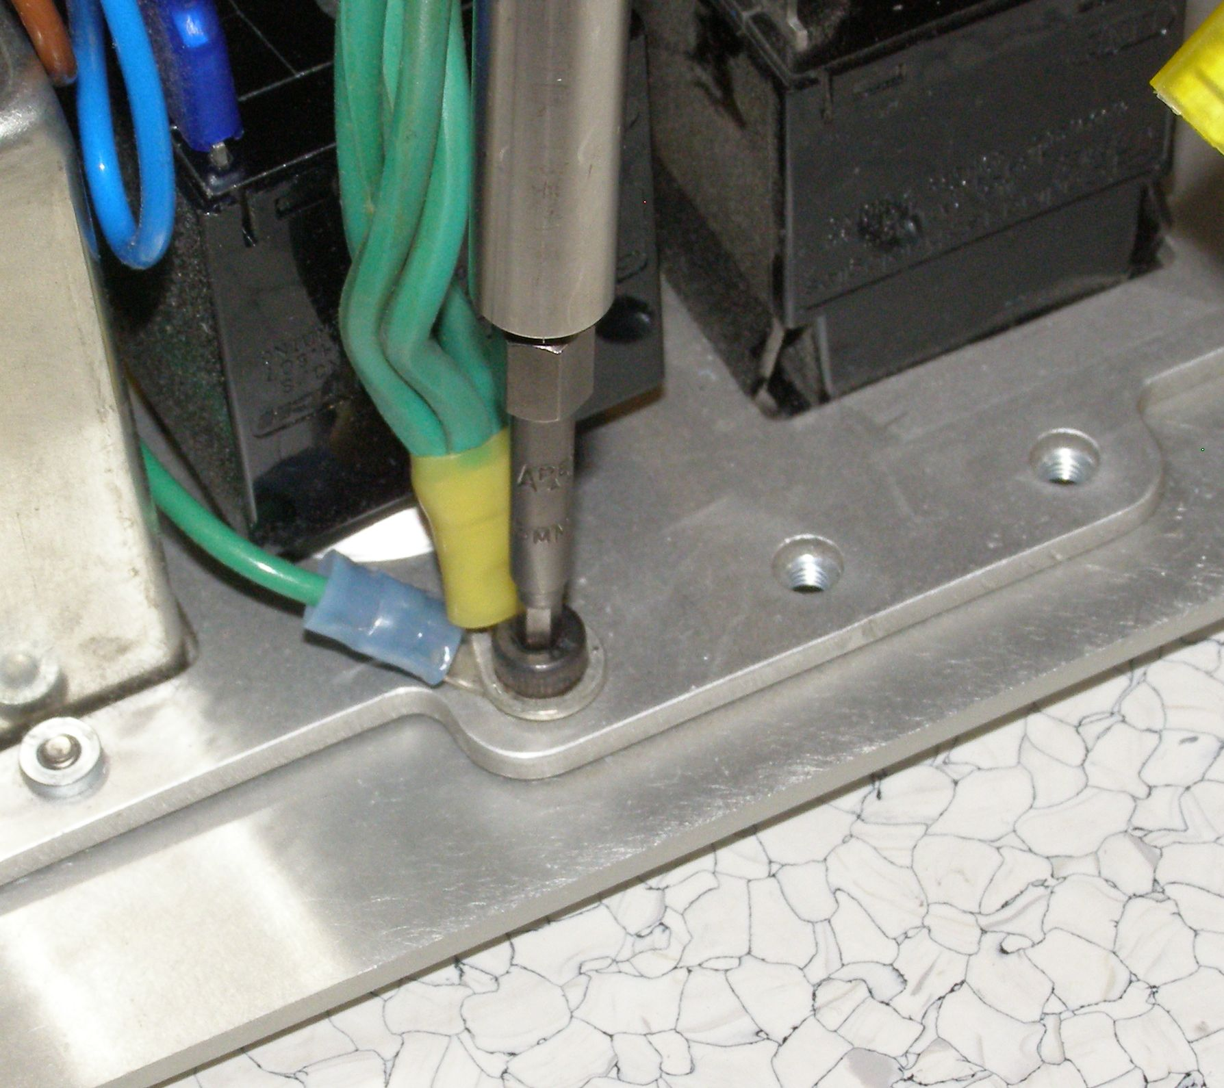
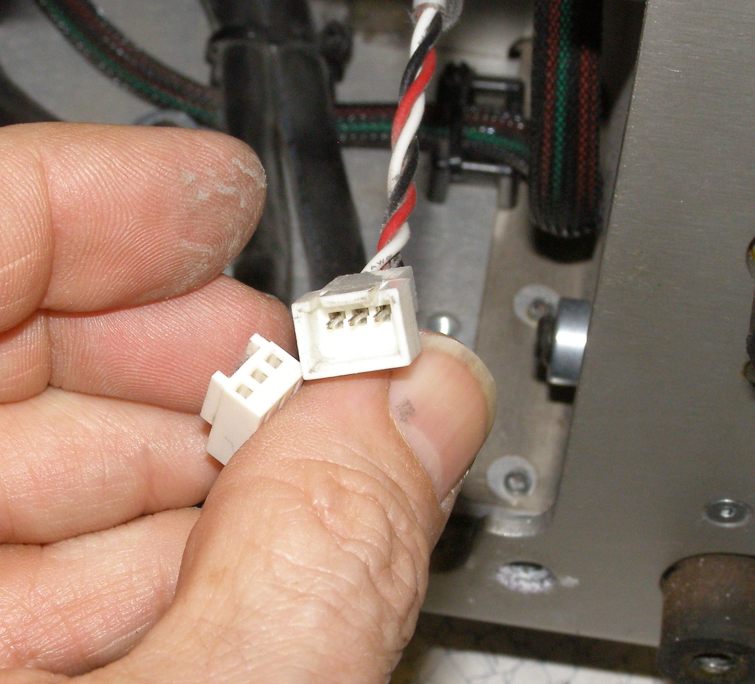
Power Receptacle R/R
Caution: The DC power from the Battery is live. The lug of the Red twisted wire shown in figure 5 must not come in contact with any metal after removal.
While it is not absolutely necessary, using insulated gloves to remove the two Red wires from the DC breaker is recommended.
  Remove the 4 wires from the DC breaker. (Fig 6)
  Using the 2.5mm bit with the T-handle remove the screw on the grounding wires. (Fig 7)
  Remove the 2 wires (Black + White) from the AC breaker. (Fig 8)
Fig 6
Fig 8
  Cut the zip-tie as shown. (Fig 9)
  Disconnect the White Fan connector. (Fig 10)
Fig 7
Fig 9
Fig 10

Slide 4
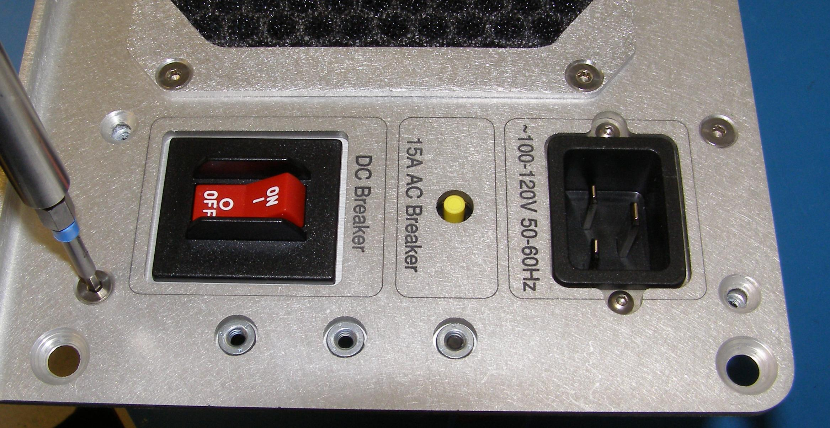
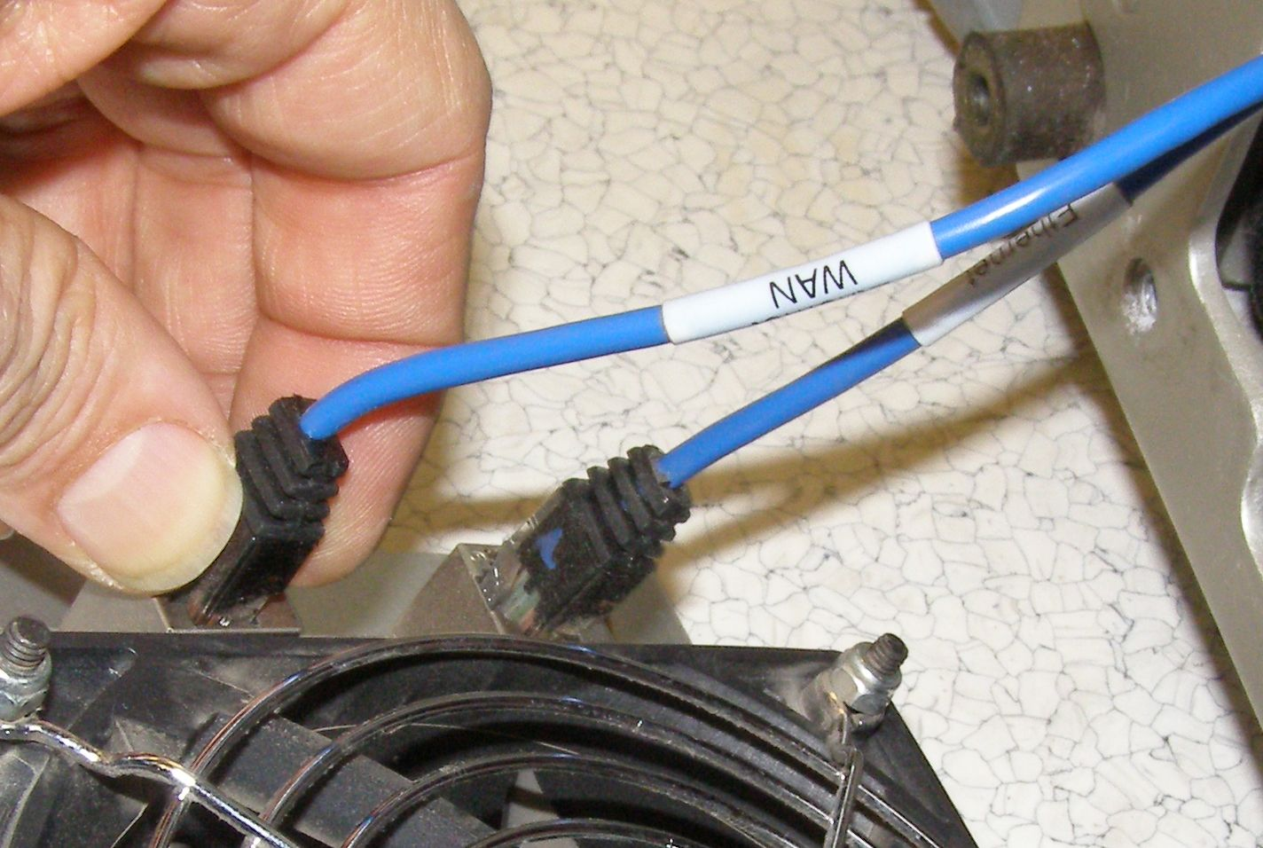
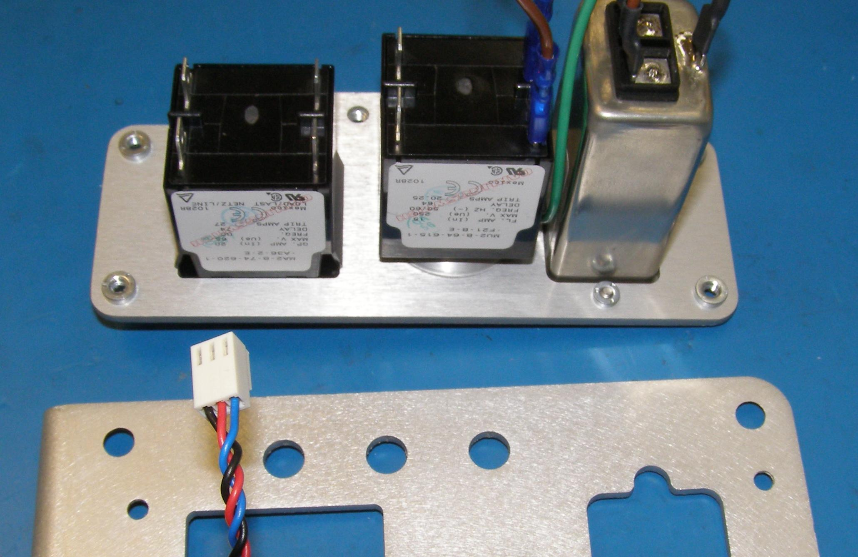
Power Receptacle R/R
Remove the Rear Base Sub-assembly 68-02810 to a suitable workplace to continue the removal of the 68-04046 Rear Sub-panel Assembly.
  Using the 2.5mm bit with the T-handle remove the 4 mounting screws. (Fig 11)
  Remove the damaged assembly and replace with the new assembly. Using Loctite 248, install the 2 bottom screws first and torque to 1.68Nm using the Large torque driver. (Fig 12)
  Using Loctite 248, install the 2 top screws and torque to 1.68Nm using the Large torque driver. The aluminum panel will bow slightly, this is OK.
  Reconnect the White fan connector as shown in figure 10.
  Attach a zip-tie as shown in figure 9.
  Starting with the Black and White spade lugs plug in the 6 AC and DC breaker wires. Do not swap the two Red or two Black wires. (Fig 5)
  Using Loctite 248, install the grounding screw and torque to 1.68Nm using the Large torque driver. (Fig 7)
  Carefully slide the rubber boot over the AC breaker and AC inlet as shown in figure 2.
  Plug in the Ethernet cables with the WAN cable at the top of the panel. (Fig.13)
  Carefully position the panel on the rear of the Robot and using Loctite 248, install the 4 screws and torque to 6.34Nm using the Large torque driver. (Fig 1)
  Reinstall the Skirt referring to Doc10.
Fig 11
Fig 13
Fig 12

